Slide 1
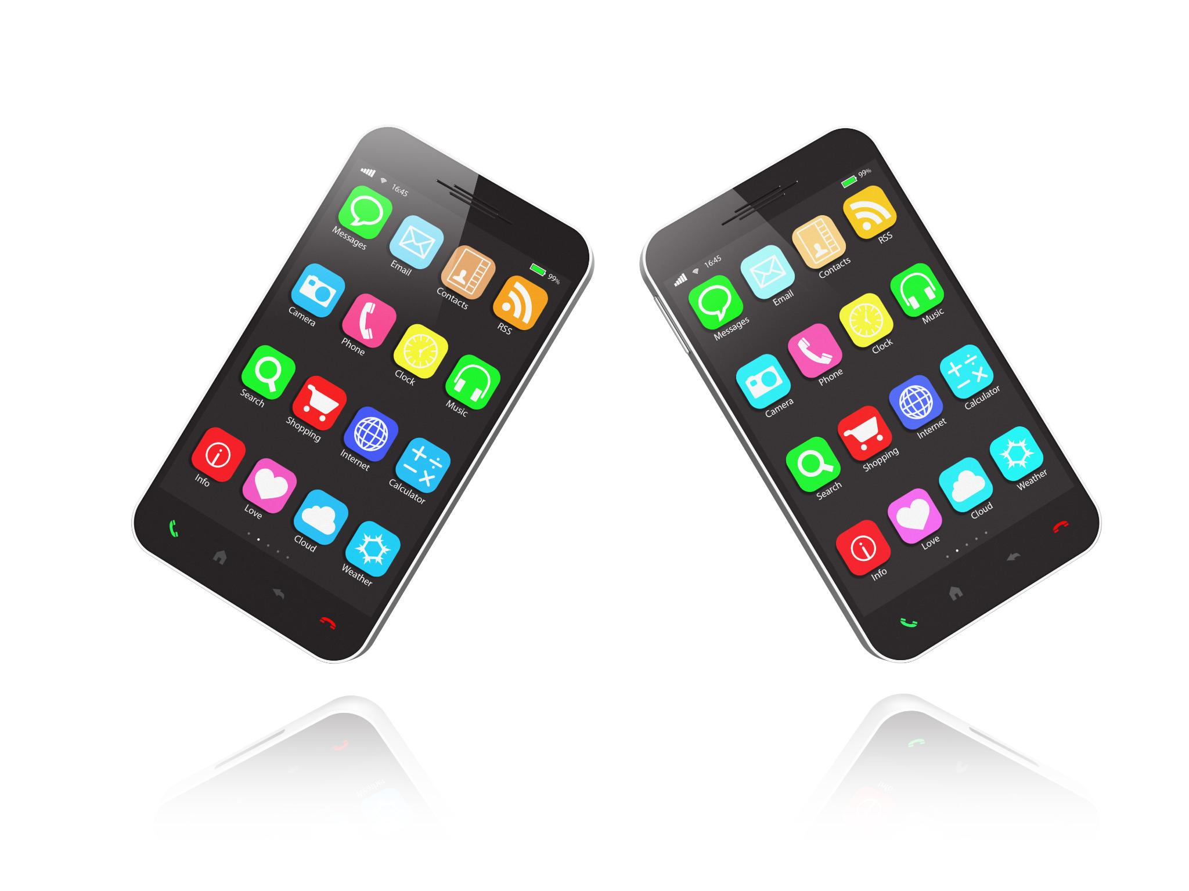
Android Widgets Overview
Introduction to interactive app components on Android devices
Notes:
AI-generated content may be incorrect. ---

Slide 2
Introduction to Widgets
Notes:
Understanding Android Widgets

Slide 3

Understanding Android Widgets
Core Android Widgets
Widgets like TextView, EditText, Button, and ImageView are basic UI components in Android applications.
Widget Customization
Android widgets can be customized using attributes like layout size, padding, margins, and text styles.
Interactive Functionality
Widgets enable user interaction such as data input and event triggering within Android apps.
Custom and Compound Widgets
Developers can create custom widgets by extending or combining multiple widgets for advanced features.
Notes:
Widgets in Android are fundamental building blocks of the user interface. They are UI components that allow developers to create interactive and visually appealing applications. Common widgets include TextView, EditText, Button, ImageView, and many others. These components are defined in XML layout files and can be manipulated programmatically in Java or Kotlin. Widgets help in displaying information, collecting user input, and performing actions. For example, a TextView displays static text, while an EditText allows users to enter data. Buttons are used to trigger events such as submitting a form or navigating to another screen. Android provides a rich set of attributes for customizing widgets, including layout dimensions, padding, margins, text styles, and event listeners. Understanding how to use and configure widgets is essential for building functional and user-friendly Android applications. Developers can also create custom widgets by extending existing ones or combining multiple widgets into a compound component. This flexibility makes Android widgets a powerful tool for UI design and interaction.

Slide 4
TextView
Notes:
Displaying Text with TextView

Slide 5
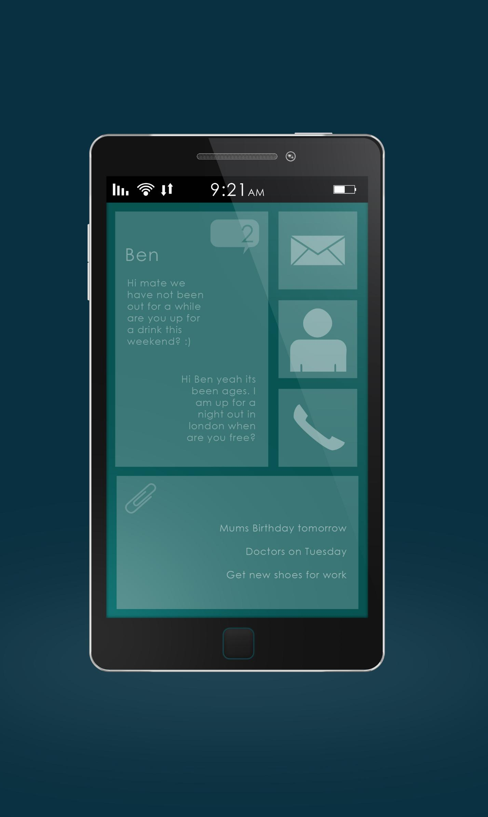
Displaying Text with TextView
TextView Basics
TextView is a non-editable Android widget used to display static text content.
Customization Options
TextView supports text size, color, style, gravity, and background customization for flexible UI design.
Dynamic Text Updates
TextView text can be updated dynamically in code, enabling personalized user messages.
Advanced Features
Supports multiline text, HTML formatting, clickable links, drawable icons, and padding adjustments.
Notes:
TextView is one of the most commonly used widgets in Android for displaying text to the user. It is a non-editable text element that can be customized in various ways. Developers can set the text content using the android:text attribute and style it using attributes like android:textSize, android:textColor, android:textStyle, and android:gravity. TextView supports multiline text, HTML formatting, and even clickable links if configured properly. It is ideal for labels, instructions, and any static text content in the UI. TextView can also be updated dynamically in code using methods like setText(). For example, a TextView can display a welcome message that changes based on the user's name. Additionally, TextView can be styled using themes and styles to maintain consistency across the app. It supports drawable icons, padding, and background customization. Developers often use TextView in combination with other widgets to create informative and interactive layouts. Understanding the capabilities and limitations of TextView is crucial for effective UI design in Android.

Slide 6
EditText
Notes:
Capturing User Input with EditText

Slide 7
Capturing User Input with EditText
Versatile Input Types
EditText supports multiple input types like text, number, password, and email for diverse user data entry.
User Guidance and Customization
Hints, maxLines, textSize, and textColor attributes help guide users and customize EditText appearance.
Data Retrieval and Validation
Developers retrieve input using getText().toString() and use validation and error messages for accuracy.
Integration in Interactive Forms
EditText integrates with buttons and text views to create dynamic and interactive Android forms.
Notes:
EditText is a versatile widget in Android used for capturing user input. It allows users to enter text data, which can be processed or stored by the application. EditText supports various input types such as text, number, password, email, and more, specified using the android:inputType attribute. Developers can set hints using android:hint to guide users on what to enter. EditText also supports attributes like android:maxLines, android:textSize, and android:textColor for customization. It can be styled with borders, background colors, and padding to enhance usability. EditText is often used in forms, login screens, and search bars. Developers can retrieve the entered text using getText().toString() in Java or Kotlin. Event listeners like TextWatcher can be attached to monitor changes in the input. EditText also supports validation and error messages to ensure correct data entry. It integrates well with other widgets like Buttons and TextViews to create interactive forms. Proper use of EditText enhances user experience and data accuracy in Android applications.

Slide 8
Button
Notes:
Triggering Actions with Button

Slide 9

Triggering Actions with Button
Button Basics
Buttons perform actions when clicked and are essential for navigation and form submission in Android apps.
Customizing Buttons
Buttons can be customized with text, colors, icons, and backgrounds using XML attributes and code.
Handling Button Events
Developers use android:onClick or setOnClickListener() to define custom behaviors when buttons are pressed.
Button States and Layout
Buttons support pressed, focused, and disabled states, styled with selectors and aligned in layouts.
Notes:
Button is a fundamental widget in Android used to perform actions when clicked. It is typically used to submit forms, navigate between screens, or trigger specific functions. The android:text attribute sets the label of the button, while android:onClick specifies the method to be called when the button is pressed. Buttons can be customized with background colors, text styles, and icons using attributes like android:background, android:textColor, and android:drawableLeft. Developers can also use setOnClickListener() in code to define custom behavior. Buttons support various states such as pressed, focused, and disabled, which can be styled using selectors. They can be placed within layouts and aligned using layout attributes. Buttons are often used in combination with other widgets to create interactive interfaces. For example, a Button can be used to validate input from an EditText and display the result in a TextView. Understanding how to configure and handle Button events is essential for building responsive Android applications.

